Slide 1
Ansible automation across secure enterprise environments
Chad Elliott
Red Hat Cleared Maintenance Engineer

Slide 2
What problem were we trying to solve?
Newly hired employees undergo several onboarding delays:
Provisioning user accounts
Provisioning virtual desktops
Providing appropriate system access
The process traditionally involves coordination across multiple departments, which can take several weeks to complete
Quote from customer:
“Currently, new hires can face delays in getting started due to the time-consuming process of provisioning user accounts, virtual desktops, and system access. This traditionally involves coordination across multiple departments, dragging the onboarding out. Imagine the difference a five minute process could make. Making use of automation would give new hires access to everything they need almost immediately, reducing frustration and getting them productive much faster.”

Slide 3
Red Hat Identity Management
Red Hat SSO/Keycloak
Ansible Automation Platform
Ansible Hub
Red Hat DevSpaces
Red Hat Enterprise Linux
Red Hat Satellite
Red Hat Virtualization
Event Driven Ansible
Red Hat Web console/Cockpit
What technology did we use?

Slide 4
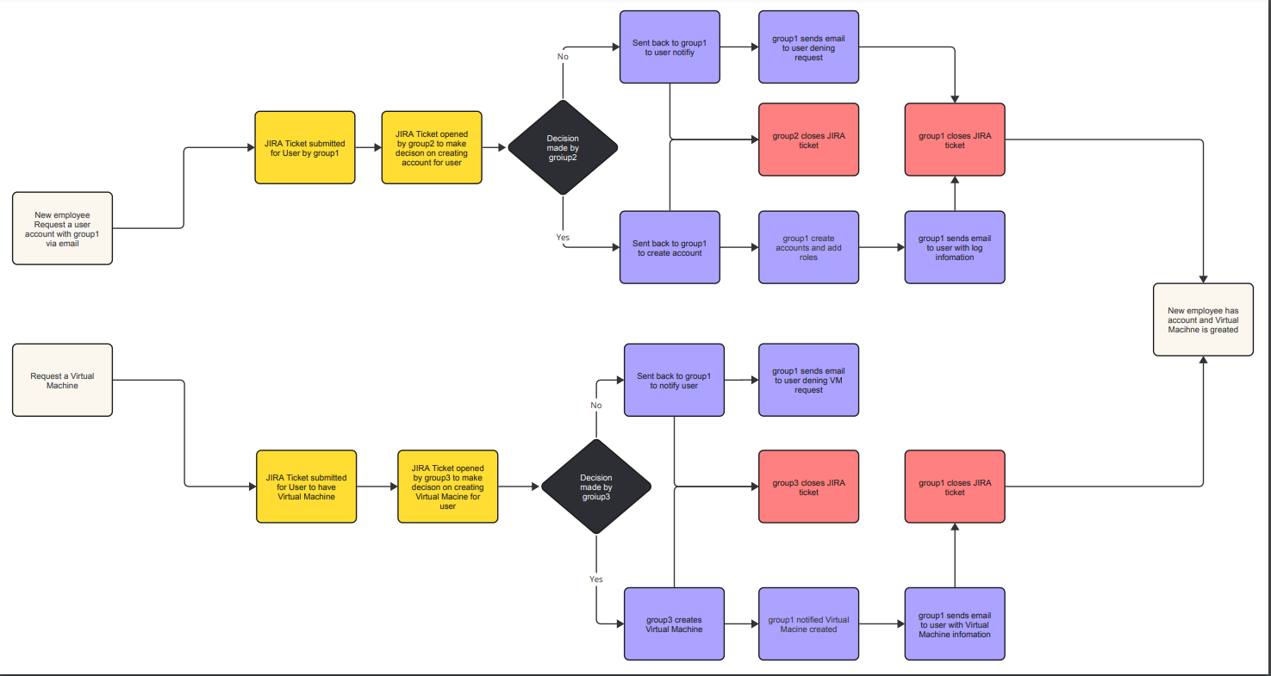
What the workflow looked like

Slide 5
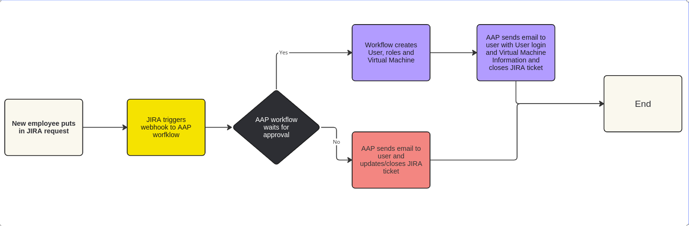
What the workflow looks like now

Slide 6
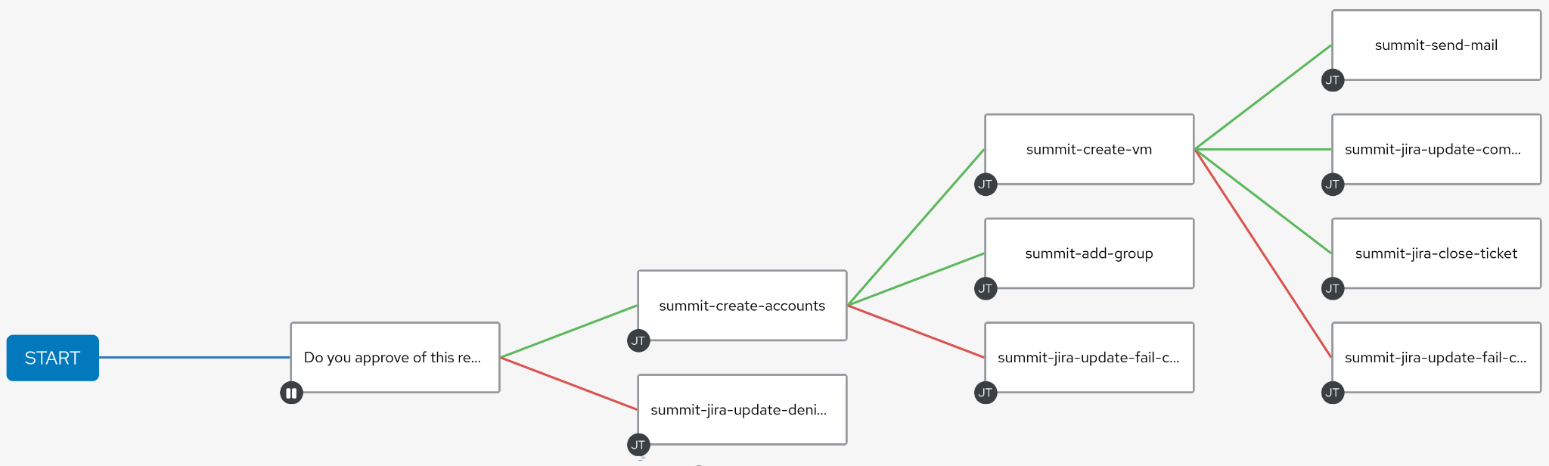
AAP Workflows to the Rescue

Slide 7
AAP Workflows to the Rescue

Slide 8
AAP Workflows to the Rescue

Slide 9
AAP Workflows to the Rescue

Slide 10
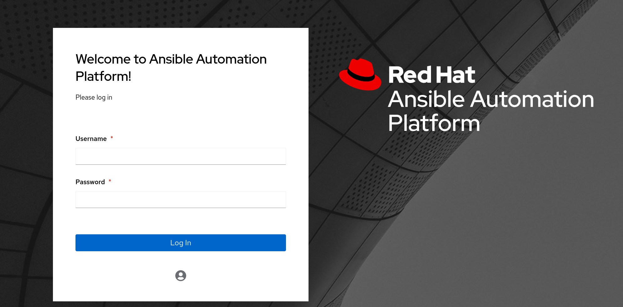
Demo

Slide 11
Questions?

